Slide 1
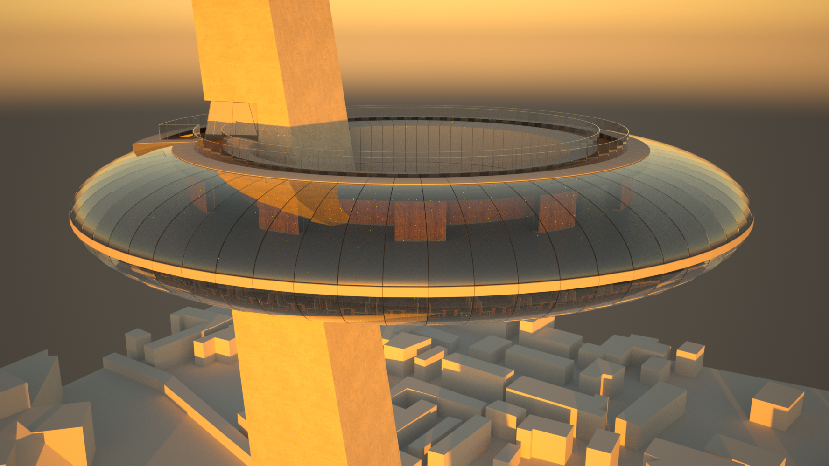
Project A: Observation
Tower In Mayflower Park
CENV3015 – Design 3
Group 1: Adam Hood Anthony Badaro David Clifford Maxence Baraniak Michael Cooper

Slide 2
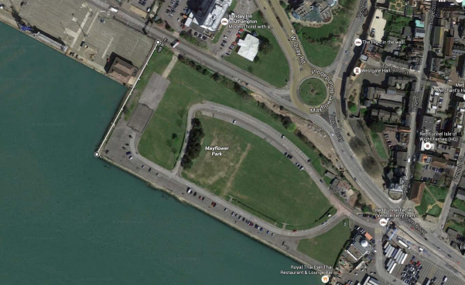
Summary of Brief
Construction of an observation tower and rotating restaurant in Mayflower Park.
Observation platform at 140m above ground level with rotating restaurant below
Minimum of 2 separate elevators required and emergency stairwell

Slide 3
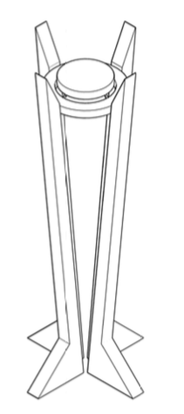
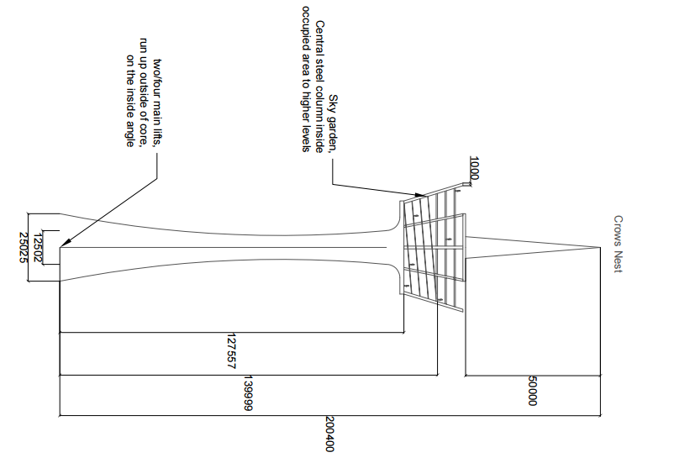
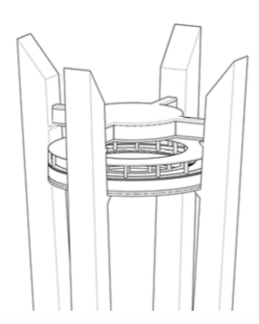
Initial Concepts
Crows Nest Tower
Trophy Tower

Slide 4
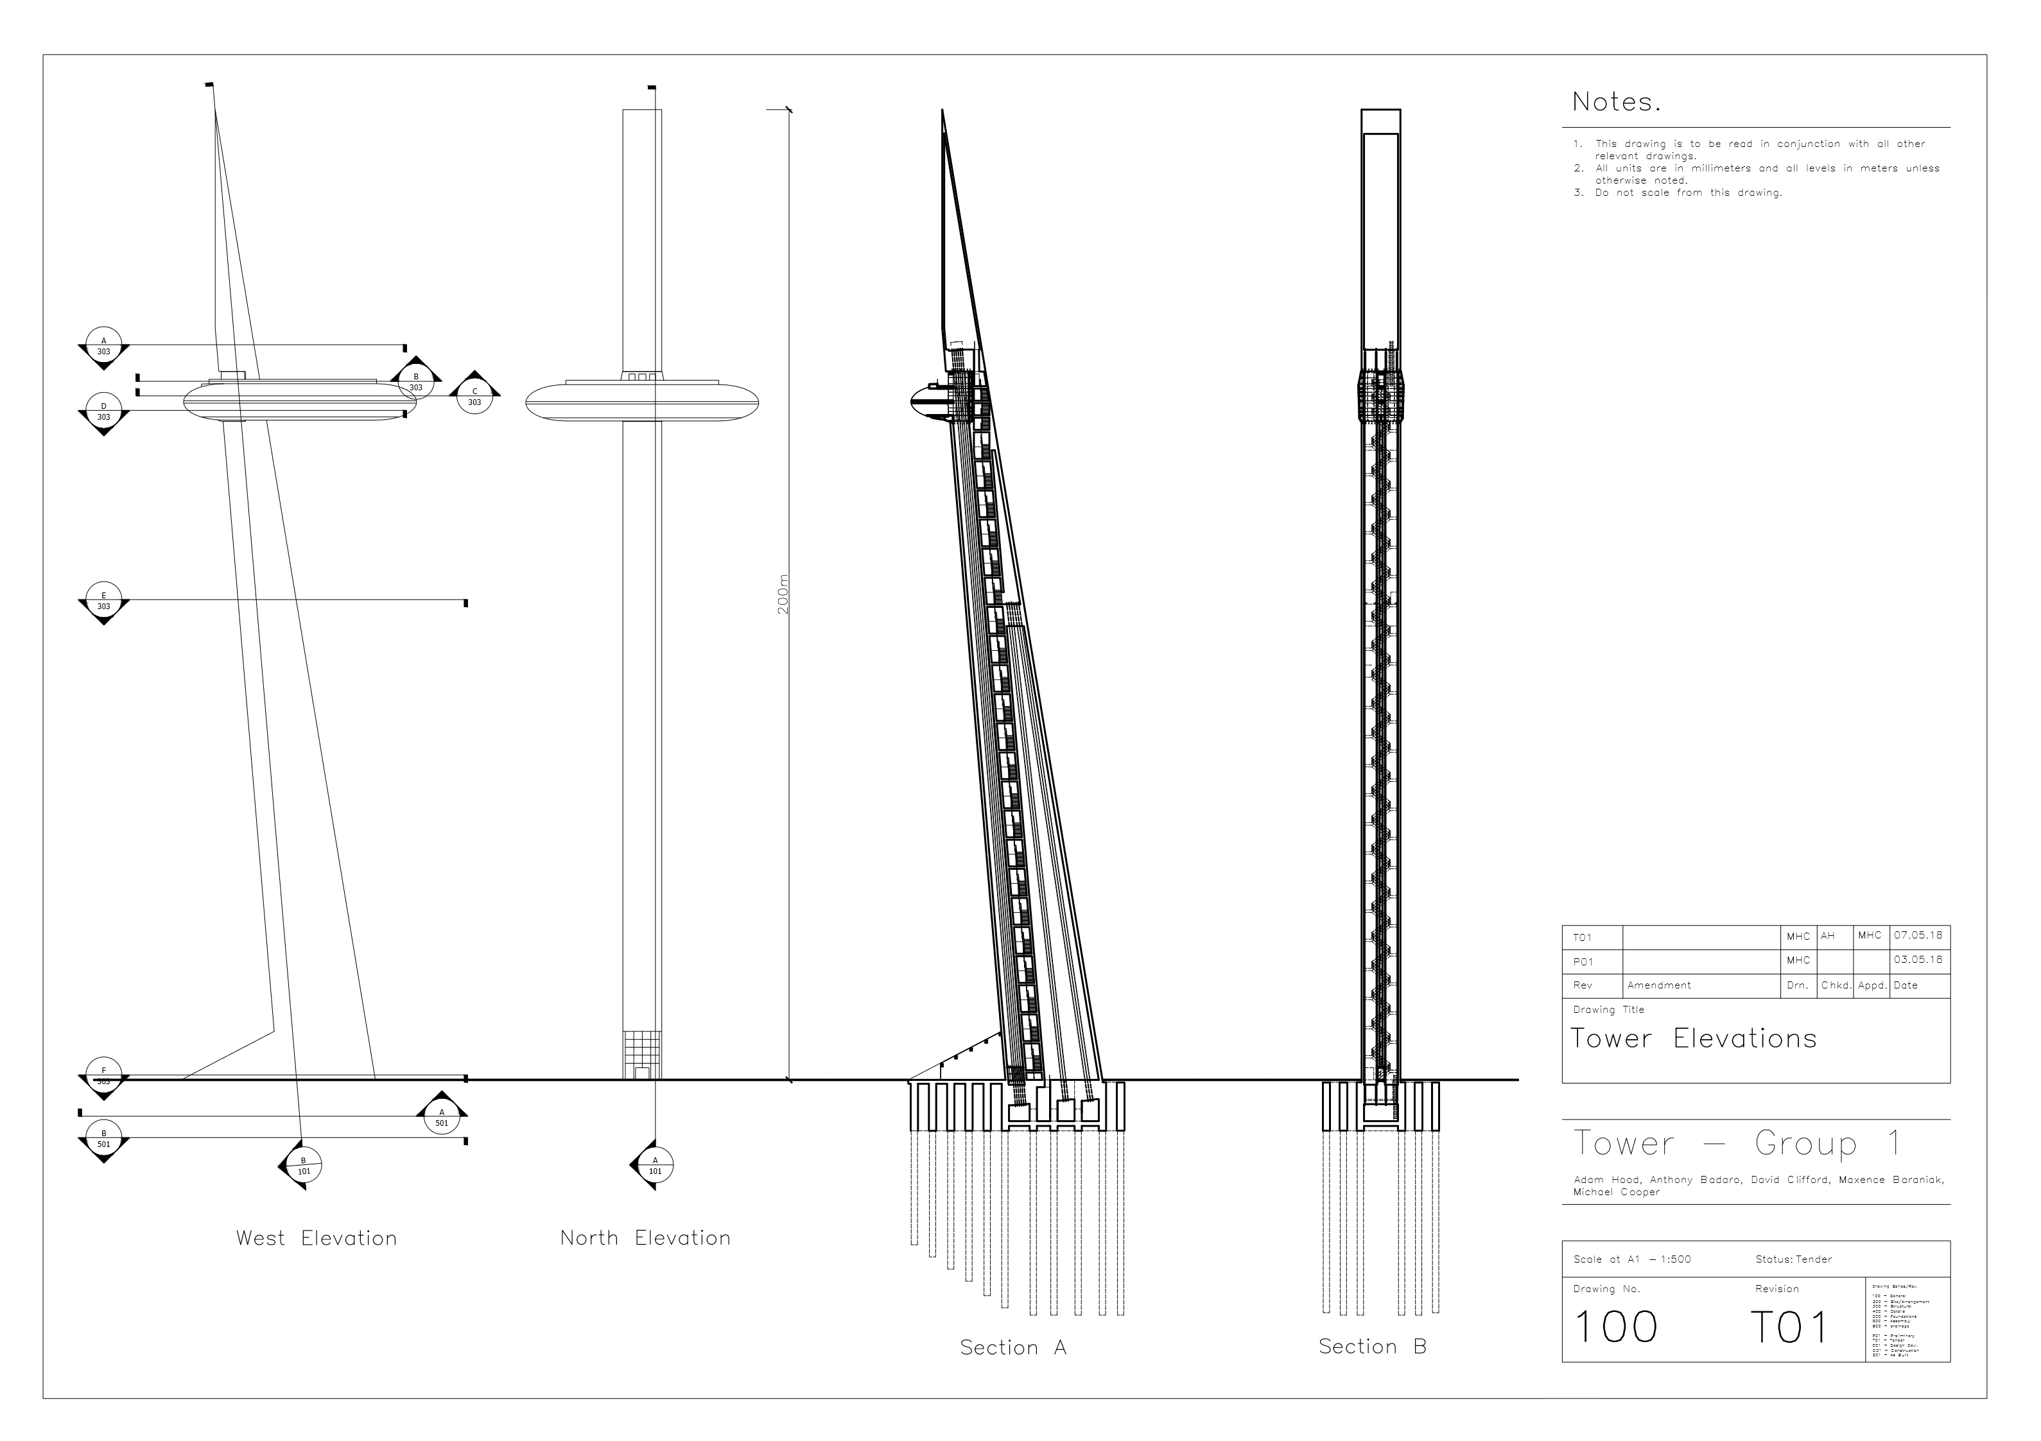
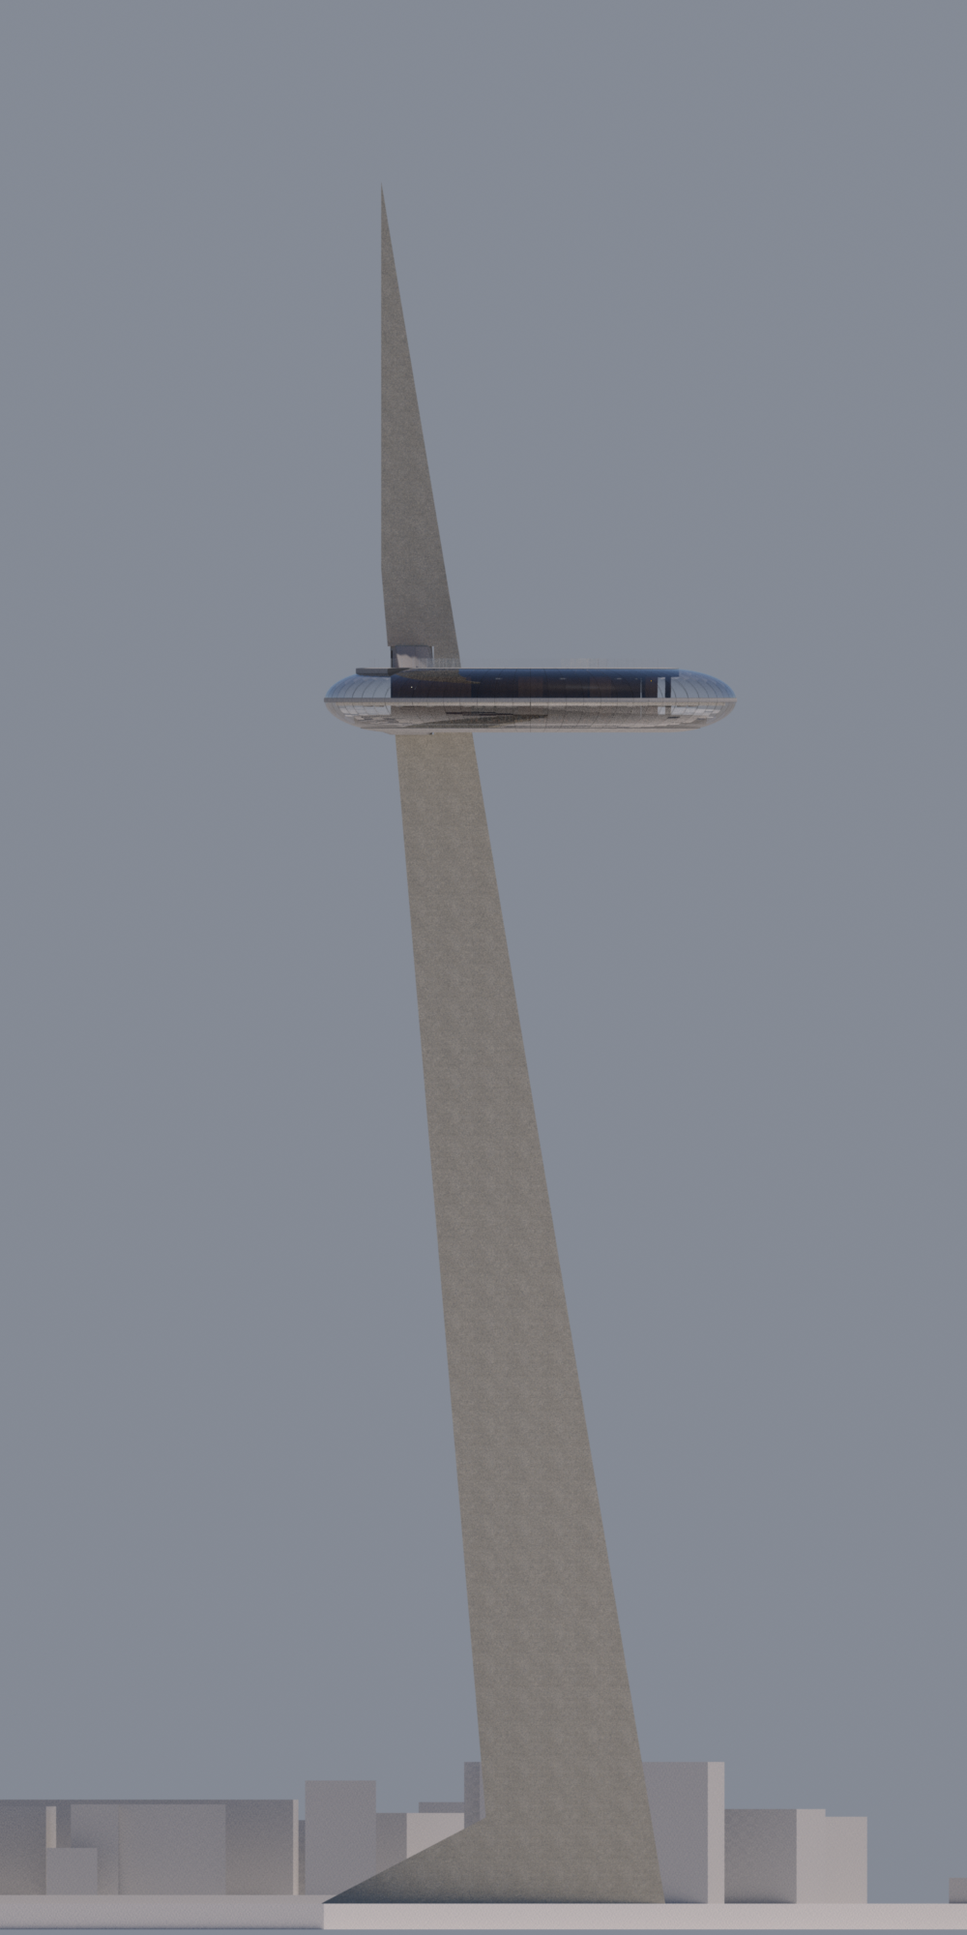
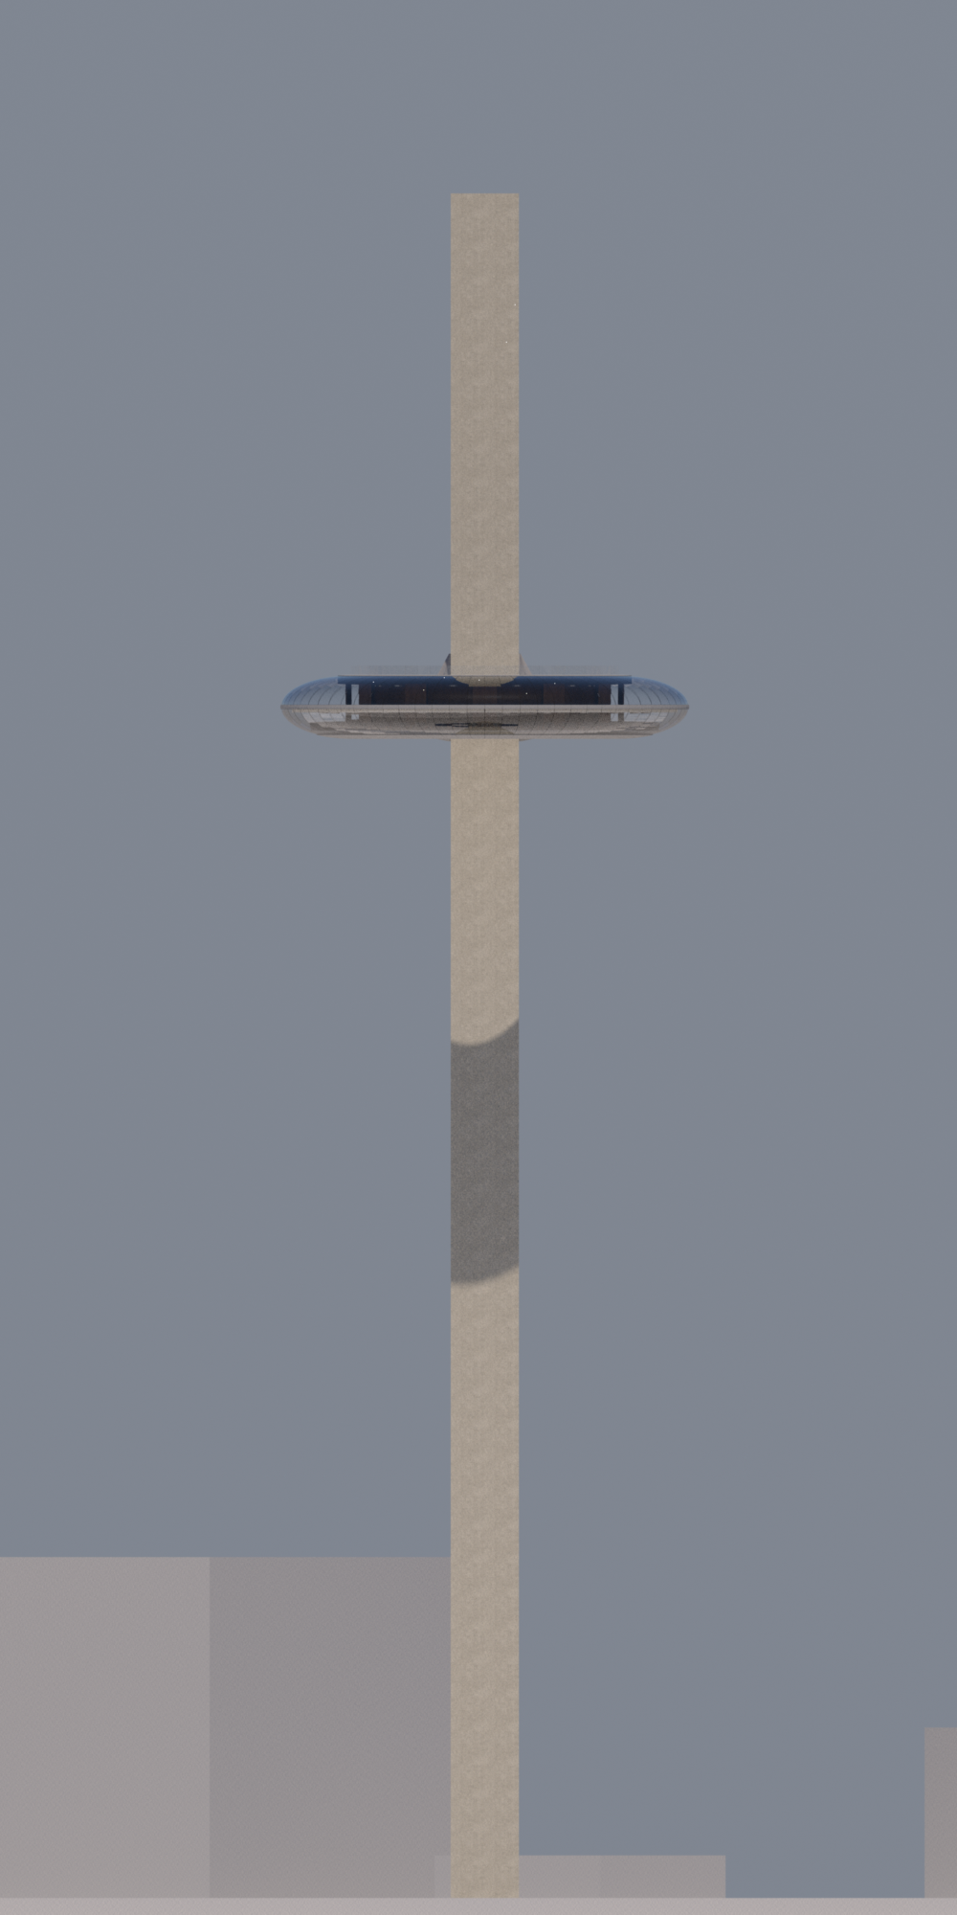
Chosen design: Halo Tower
Description:
200m high Tower
Observation deck at 145m.
Post-tensioned R.C Tower with torus shaped steel cab
Why?
Elegant shape
Interesting and challenging structural design
Fulfills requirements
Tallest free standing structure outside London

Slide 5
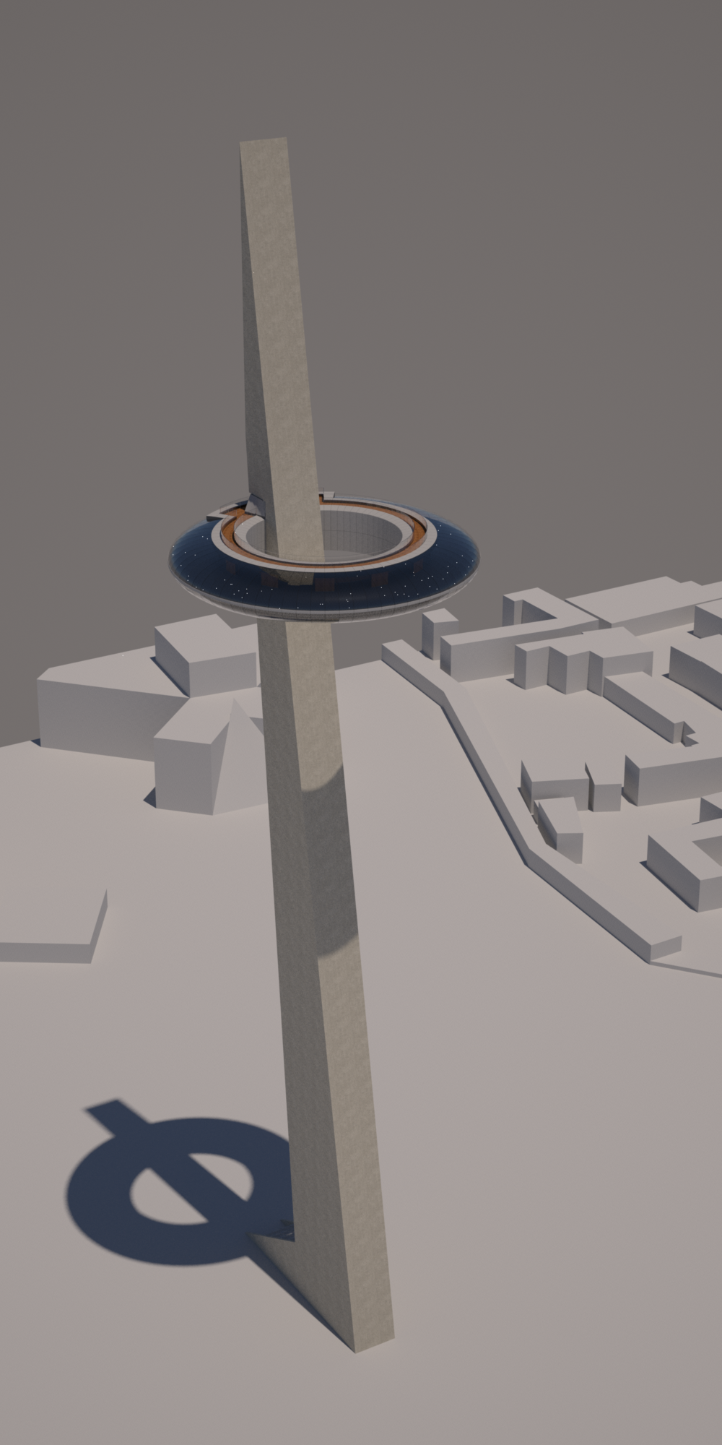
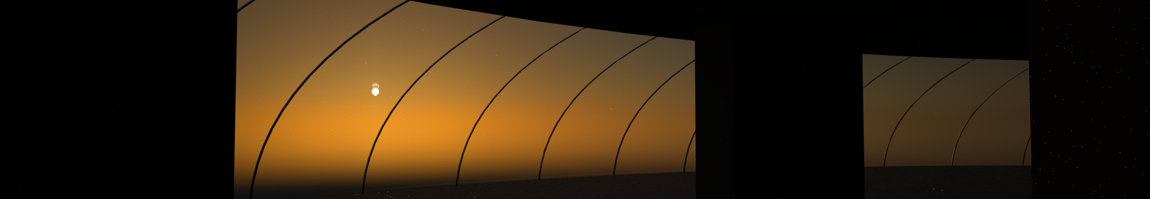
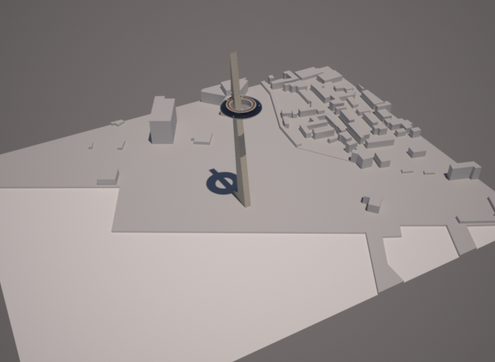
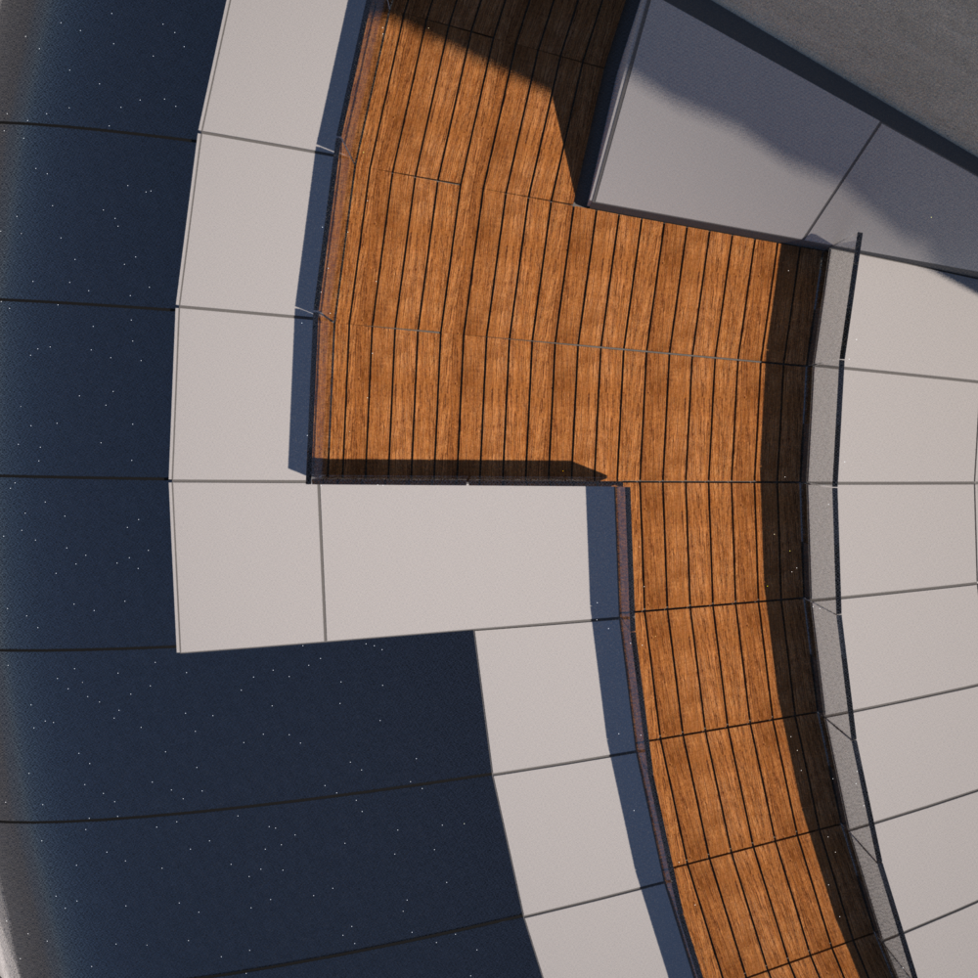
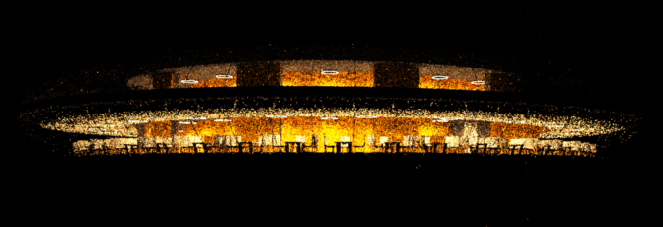

Slide 6
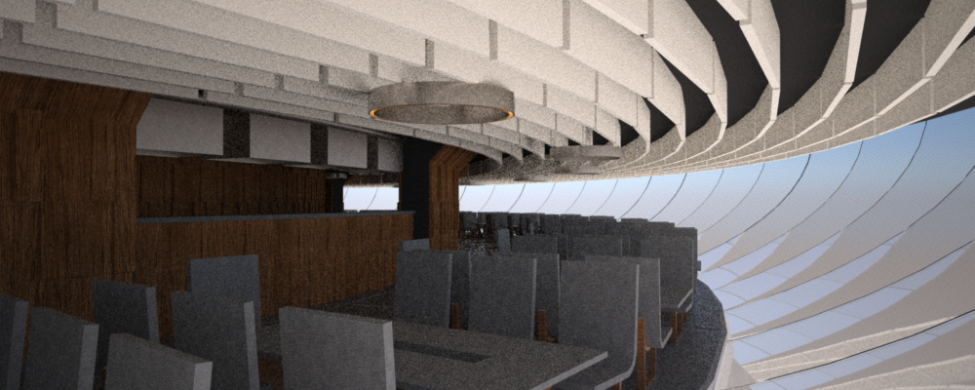
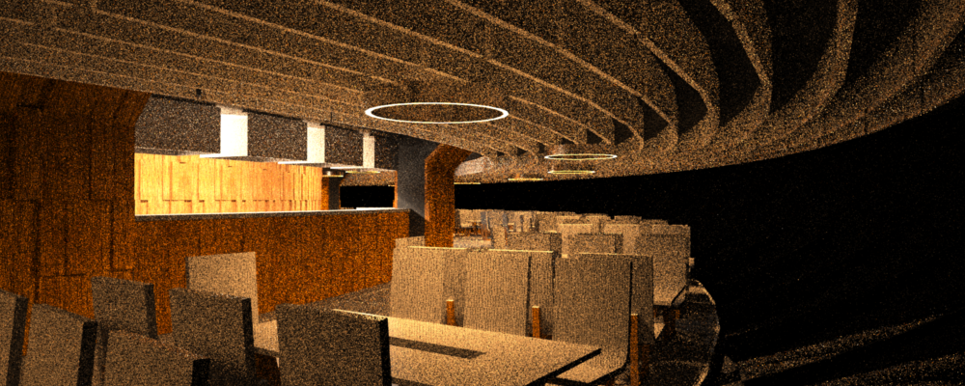
The Cab
Torus shaped stress skin steel structure
Consists of 3 floors
First Floor - restaurant with rotating turntable
Second Floor - Observation deck
Third Floor - Open air walkway

Slide 7
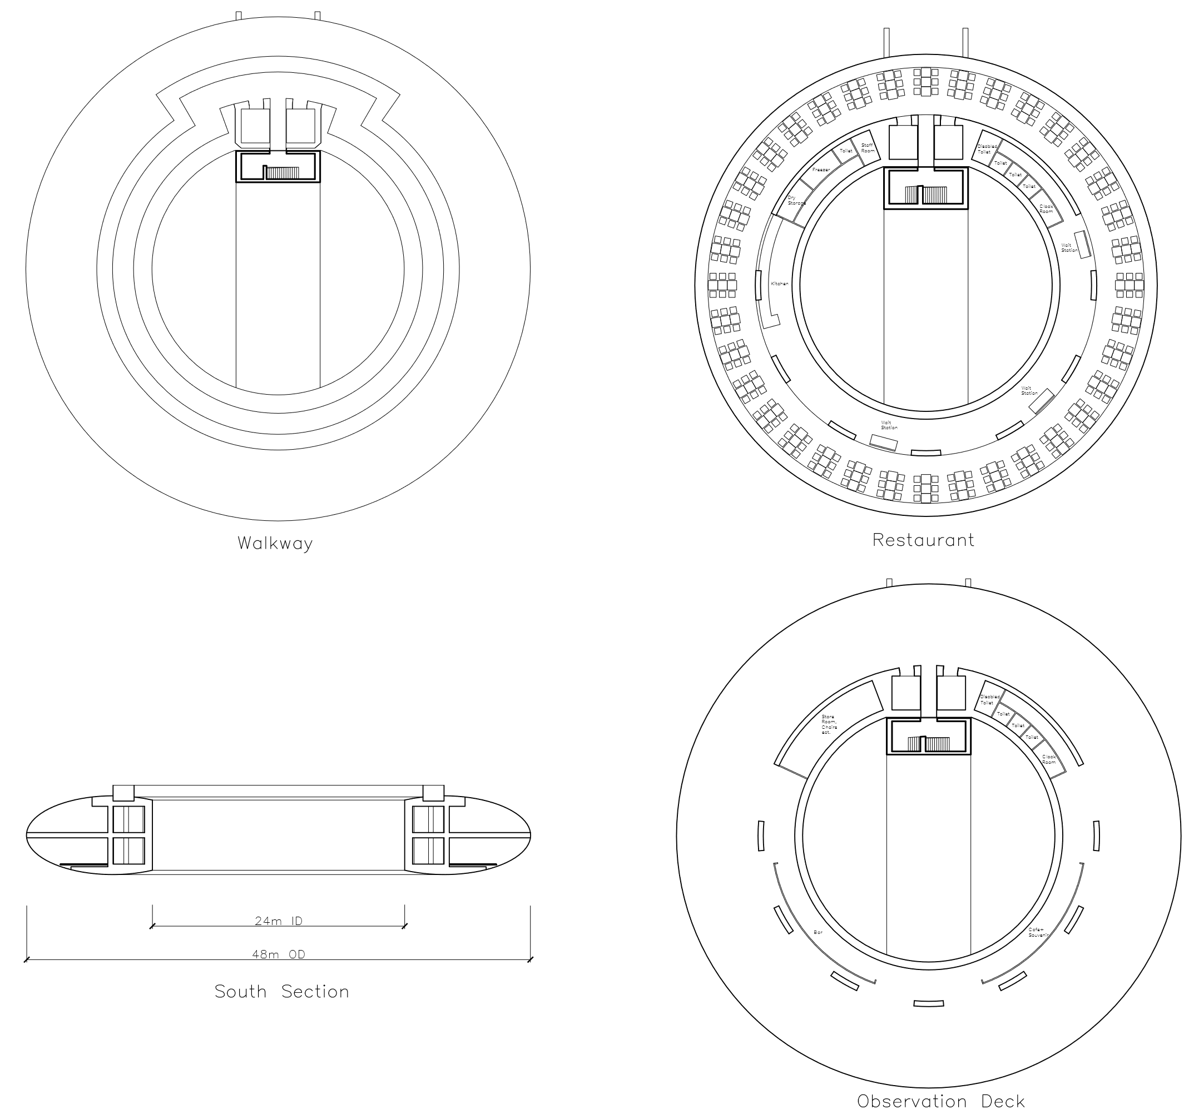
Internal Layout
Architectural sections
Open Kitchen
All facilities available at cab level
Toilets
Cloak room
Capacity of 200 people
Designed for crowd loading (5kN/m²) to allow for functions

Slide 8
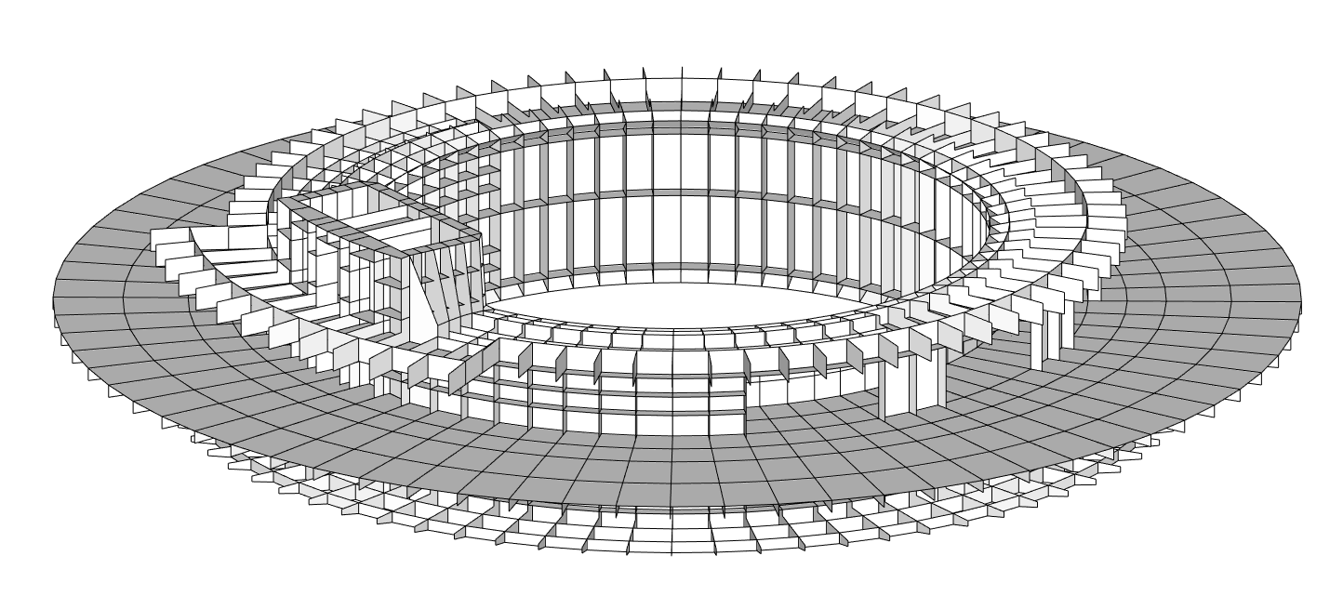
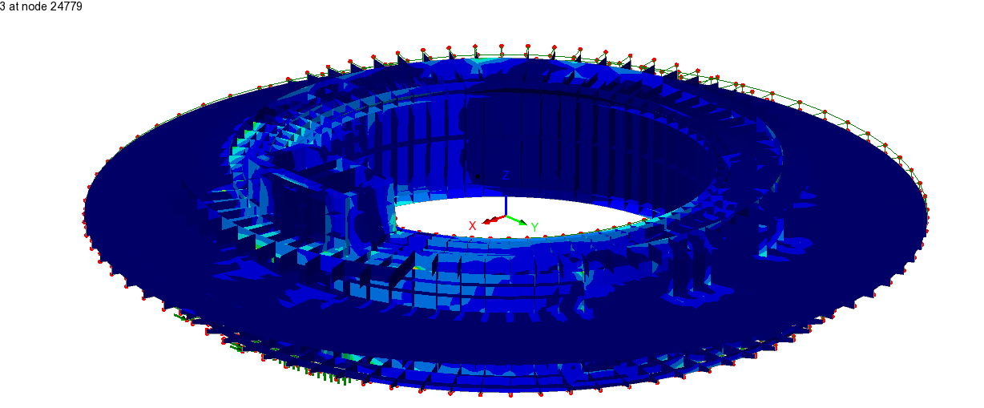
Stress Skin
Stress skin structure utilizes steel plate welded to full strength (S500 steel)
Plate thicknesses ranging from 15 to 80 mm.
Structure is designed as 1 sided single skinned to ensure weldability.
Stiffeners placed at regular intervals to prevent local buckling.

Slide 9
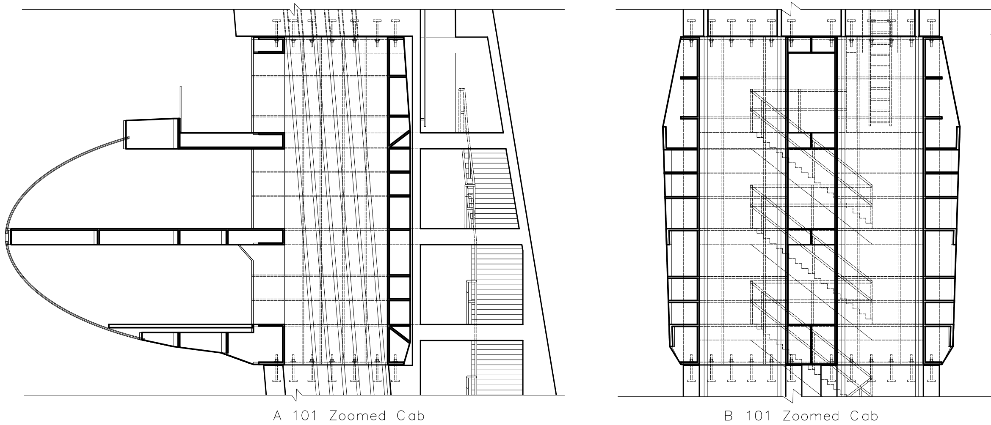
Tower Connection
Steel and Tower lift shafts are aligned allowing lifts into the cab
Post tension cables also pass through the lift shafts to clamp the Halo in place
Bolted connection with bearing plates to prevent movement during construction phase

Slide 10
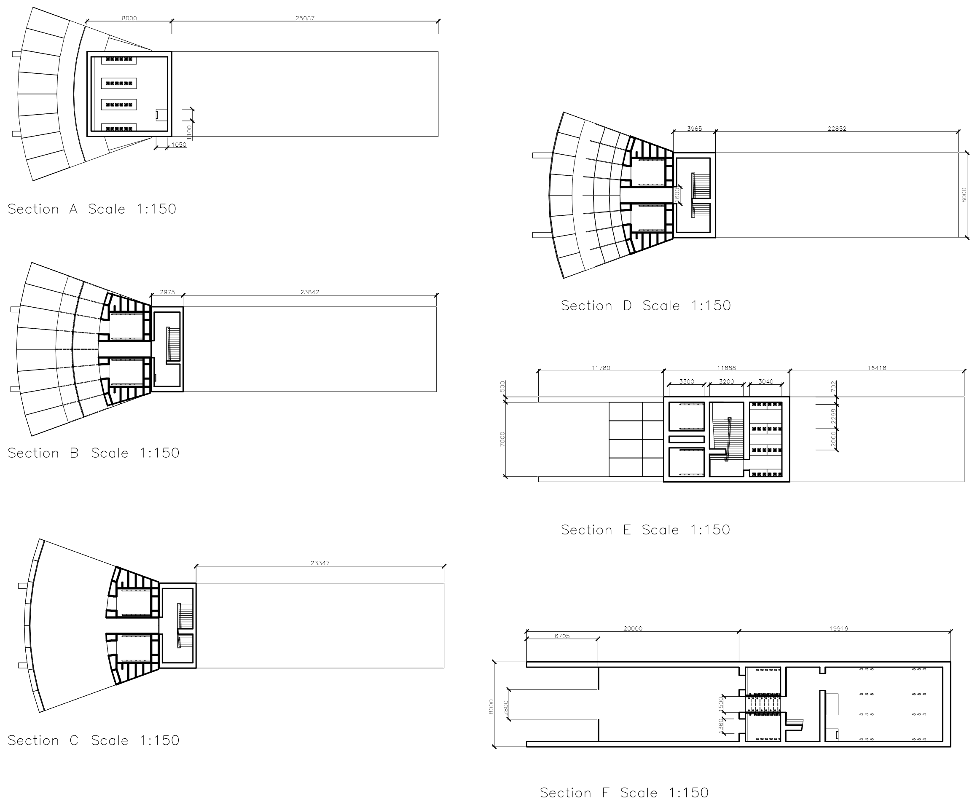
The Tower
Hollow concrete tower with typical wall thickness of 0.5m
Inclined at 5º degrees to the vertical
8m wide and tapers from 20m long at the base to 9m below the cab
2 lift shafts and an emergency stairwell fully compliant with fire safety regulations (RRFSO 2005)

Slide 11
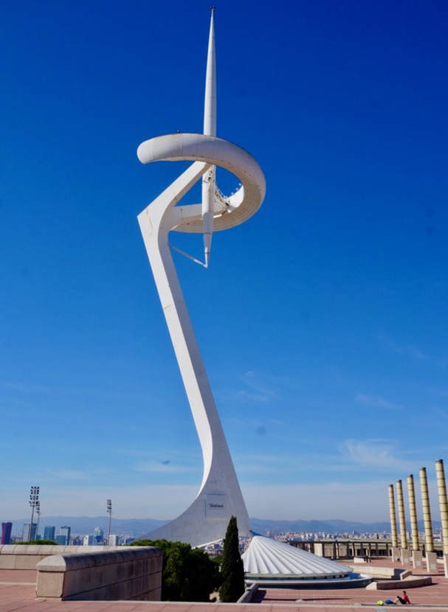
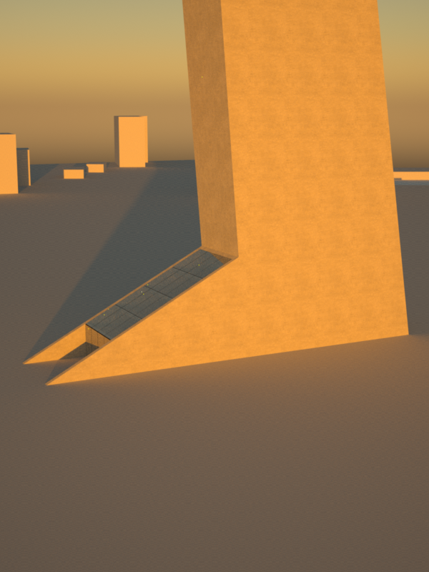
Entrance Hall
Entrance hall based on supporting tails of Barcelona Olympic Tower
8 m wide and 22 m long
Glass roof to admire roof above
Glass is sufficient to withstand maintenance loading thereby removing the need for purlins

Slide 12
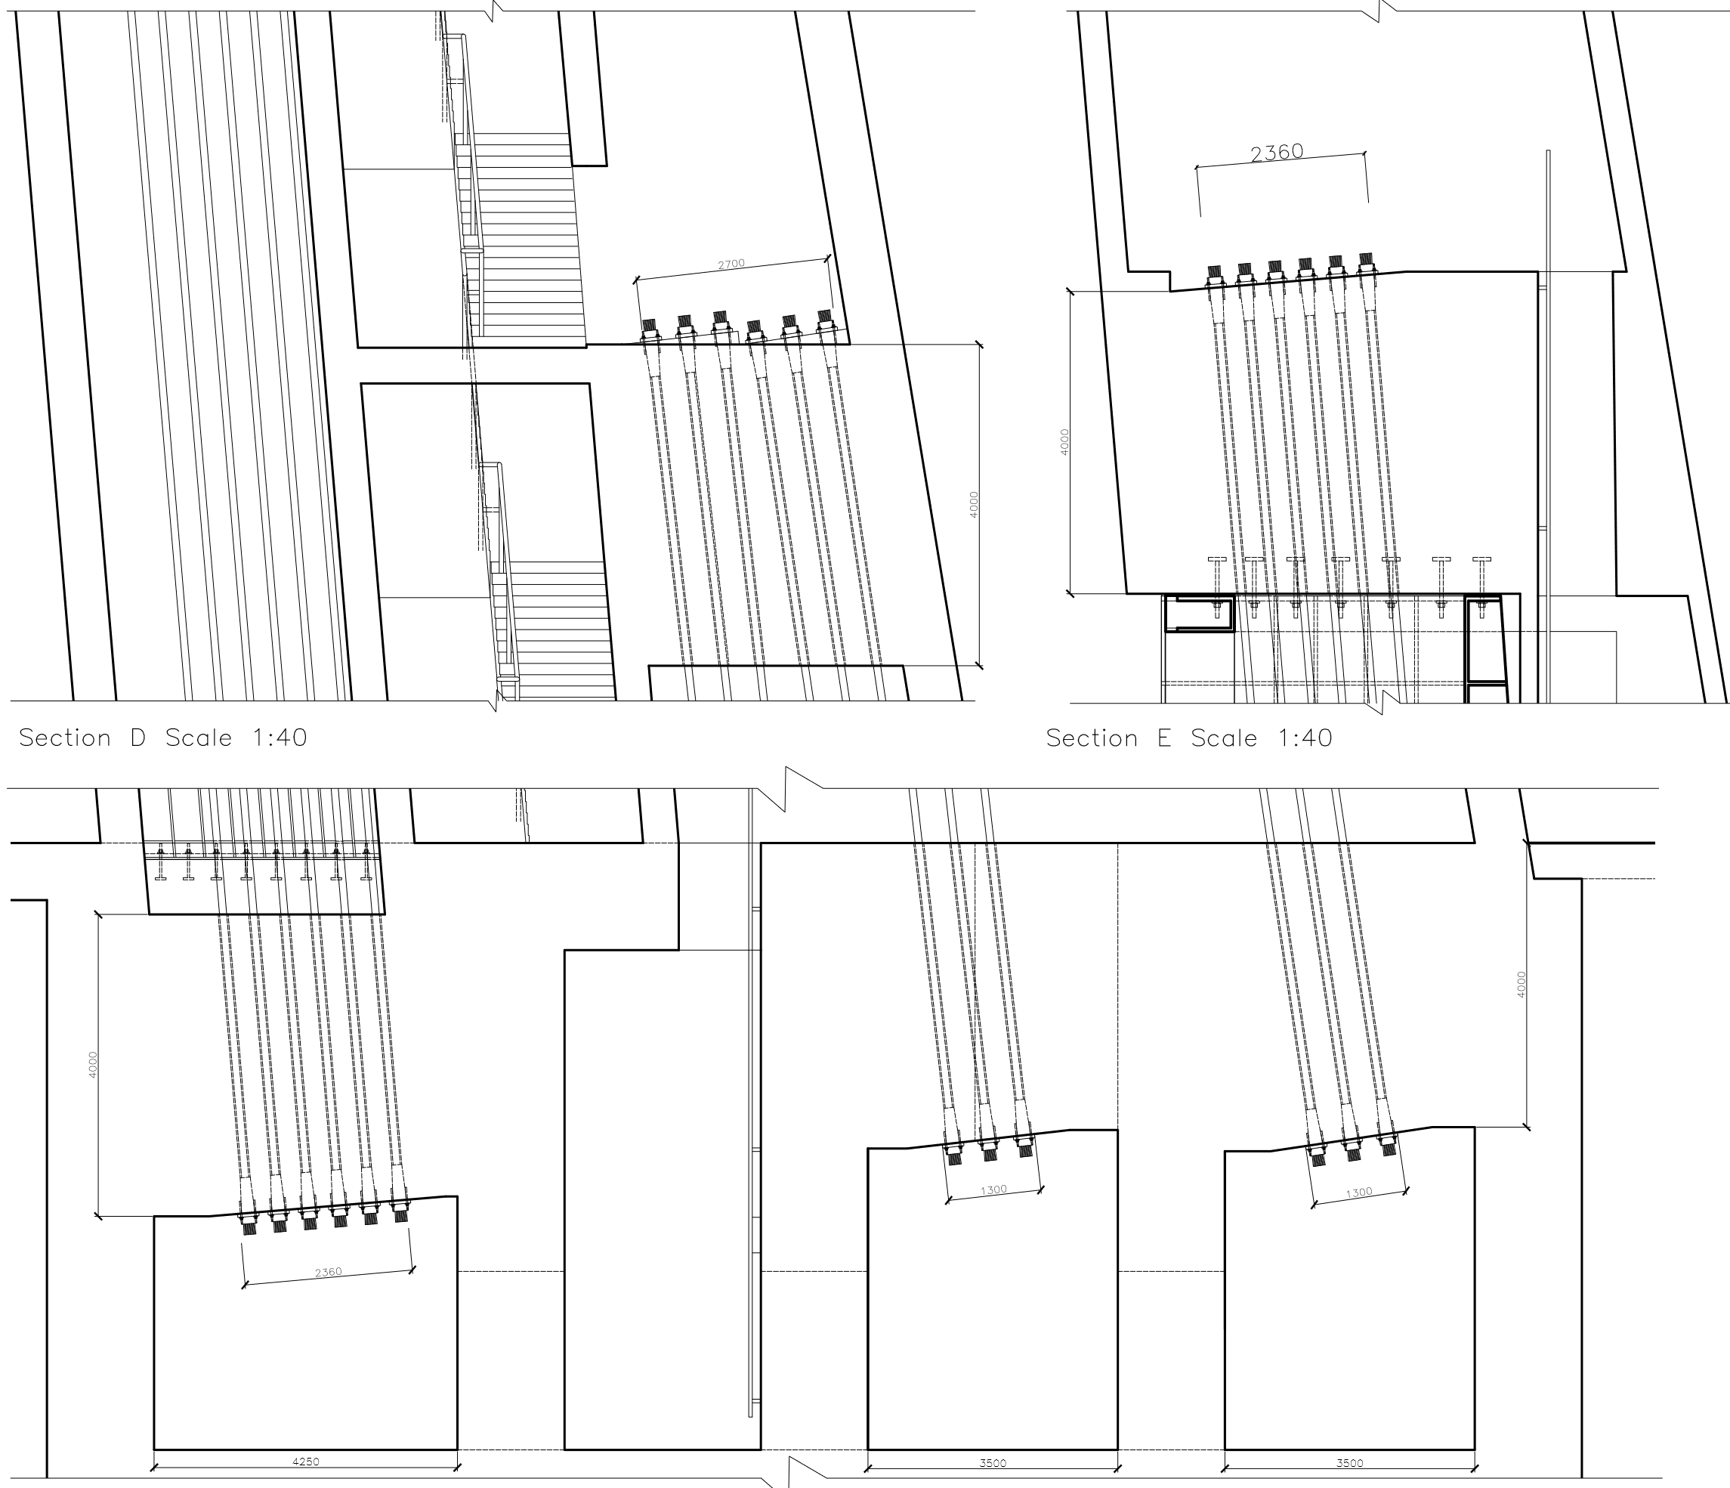
Post-Tensioning System
2 sets of post-tension systems (24 cables each):
First set positioned in the lift shafts to resist the moment induced by the Halo
Second set to control deflections of the Tower due to its self weight
Both sets combine to withstand tensile stresses at base of the Tower due to wind loading
Inspection and jacking rooms in the basement.
End Blocks
Each cable attached to the Tower via end blocks
All blocks are 4 m high and 2.6 m wide to support a maximum of 36MN
Each block resists 6 cables.

Slide 13
Foundation
System consists of a semi-rigid pile cap supported by 60 piles
1.5m diameter piles with c/c spacing of 2.5 d. (3.75m)

Slide 14
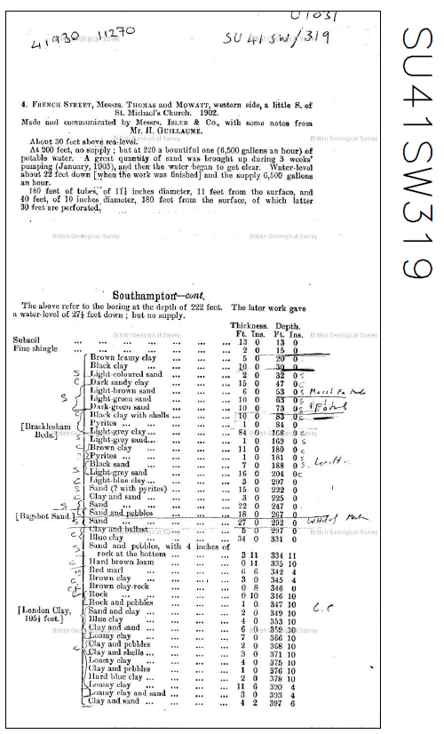
Soil Properties
Soil layers identified using the British Geological Survey GeoIndex
The deepest layer shows alternate layers of Bracklesham beds consisting of sand and clay facies.
Assumed soil conditions at the site:
0-5m: Made Ground
5-15m: Bracklesham Beds (Clay facies)
15-22m: Bracklesham Beds (sand facies)
22-30m: Bracklesham Beds (Clay facies)

Slide 15
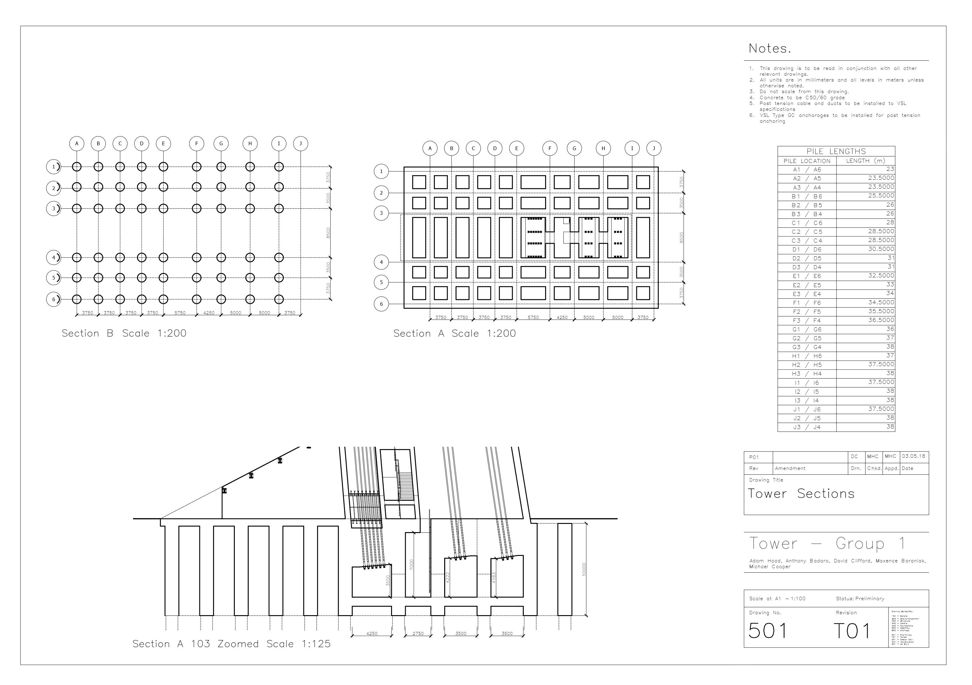
Pile Cap
10 m deep pile cap in a 6x10 grid arrangement
Pile cap in a waffle arrangement with voids to ensure economic and efficient use of concrete
Piles located at the nodes of connecting beams.

Slide 16
Pile Arrangement
Piles length calculated using drained and undrained geotechnical calculations.
Varying lengths due to the distribution of loads obtained from a LUSAS model output.
Ranging from 38m at the longest to 23m for the shortest

Slide 17
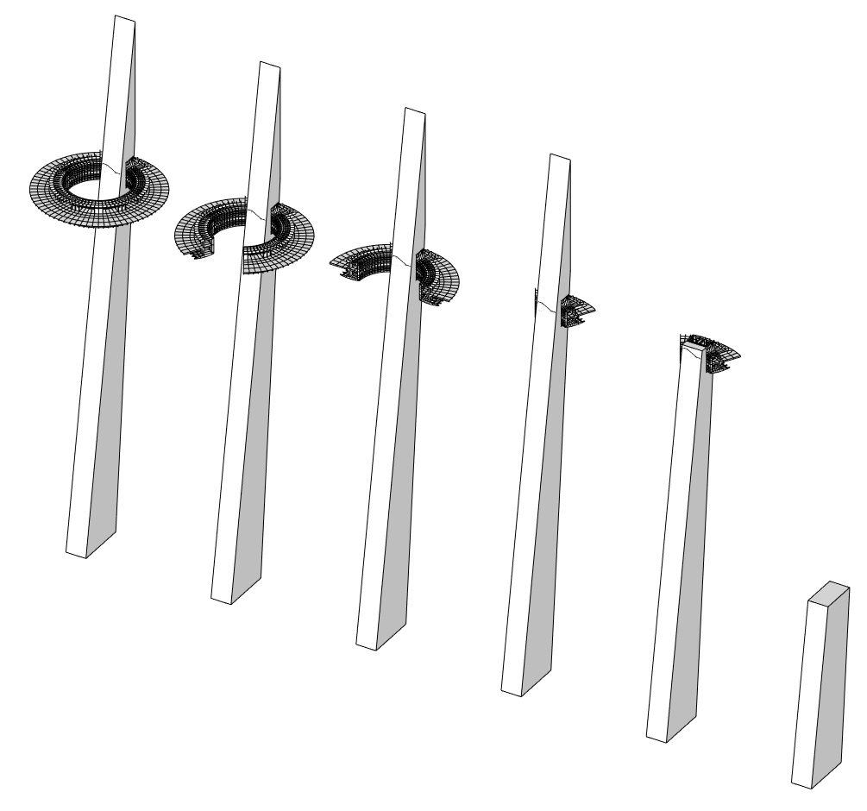
Construction process
Step 1: Foundation
Excavate 10m to base of pile cap
Install 1.5m diameter piles using continuous flight auger (CFA) piling rig
Create formwork and complete pile cap pour
Step 2: Tower
Slip form tower to 145m (just above steel cab)
Install first pre-fabricated Steel section
Install lifts to aid movement of workers
Finish slip forming tower
Step 3: Halo
Lift next two steel segments into place. temporarily bolt, then weld.
Repeat for remaining segments.
Installation of glass, cladding, and services.

Slide 18
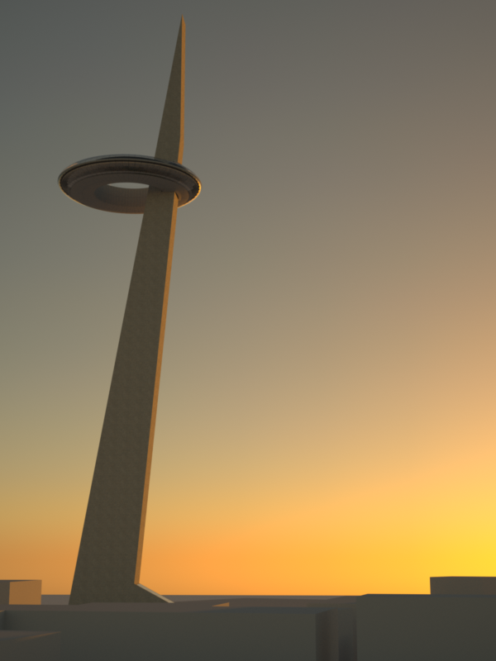
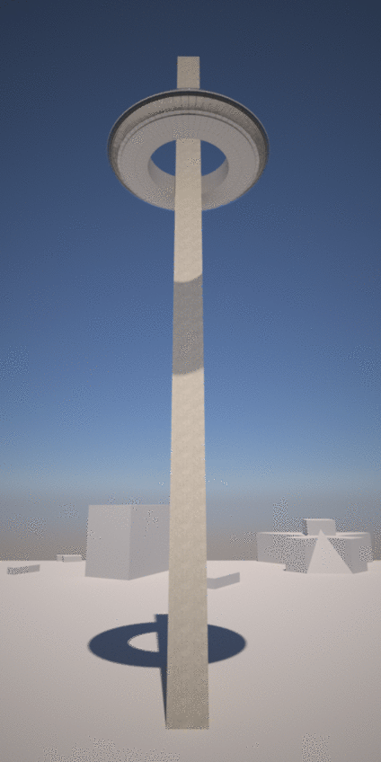
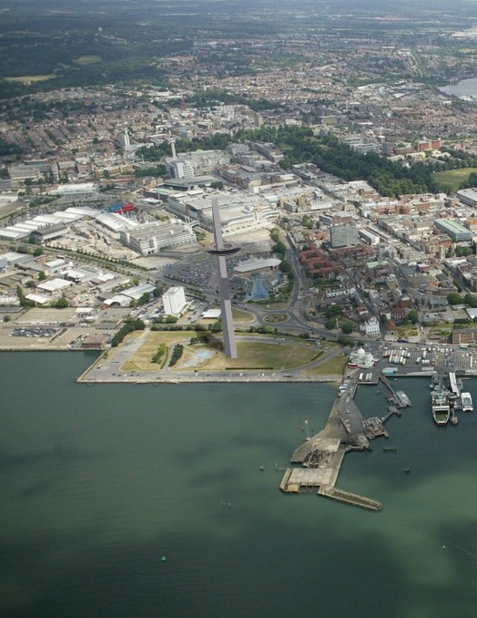
Conclusion

